Slide 1
SQL: The Query Language
CS 186, Spring 2006,
Lectures 11&12
R &G - Chapter 5
Life is just a bowl of queries.
-Anon
Notes:
The slides for this text are organized into several modules. Each lecture contains about enough material for a 1.25 hour class period. (The time estimate is very approximate--it will vary with the instructor, and lectures also differ in length; so use this as a rough guideline.) This covers Lectures 3 and 4 (of 6) in Module (3).
Module (1): Introduction (DBMS, Relational Model)
Module (2): Storage and File Organizations (Disks, Buffering, Indexes)
Module (3): Database Concepts (Relational Queries, DDL/ICs, Views and Security)
Module (4): Relational Implementation (Query Evaluation, Optimization)
Module (5): Database Design (ER Model, Normalization, Physical Design, Tuning)
Module (6): Transaction Processing (Concurrency Control, Recovery)
Module (7): Advanced Topics

Slide 2
Administrivia
Midterm1 was a bit easier than I wanted it to be.
  Mean was 80
  Three people got 100(!)
  I’m actually quite pleased.
  But, I do plan to “kick it up a notch” for the future exams.
Be sure to register your name with your cs186 login if you haven’t already --- else, you risk not getting grades.
Homework 2 is being released today.
  Today and Tuesday’s lectures provide background.
  Hw 2 is due Tuesday 3/14
  It’s more involved than HW 1.

Slide 3
Relational Query Languages
A major strength of the relational model: supports simple, powerful querying of data.
Two sublanguages:
DDL – Data Defn Language
  define and modify schema (at all 3 levels)
DML – Data Manipulation Language
  Queries can be written intuitively.
The DBMS is responsible for efficient evaluation.
  The key: precise semantics for relational queries.
  Allows the optimizer to extensively re-order operations, and still ensure that the answer does not change.
  Internal cost model drives use of indexes and choice of access paths and physical operators.

Slide 4
The SQL Query Language
The most widely used relational query language.
Originally IBM, then ANSI in 1986
Current standard is SQL-2003
    Introduced XML features, window functions, sequences, auto-generated IDs.
    Not fully supported yet
SQL-1999 Introduced “Object-Relational” concepts. Also not fully suppored yet.
SQL92 is a basic subset
    Most systems support a medium
PostgreSQL has some “unique” aspects (as do most systems).

Slide 5
DDL – Create Table
CREATE TABLE table_name ( { column_name data_type [ DEFAULT default_expr ] [ column_constraint [, ... ] ] | table_constraint } [, ... ] )
Data Types (PostgreSQL) include:
  character(n) – fixed-length character string
  character varying(n) – variable-length character string
  smallint, integer, bigint, numeric, real, double precision
  date, time, timestamp, …
  serial - unique ID for indexing and cross reference
  …
PostgreSQL also allows OIDs and other “system types”, arrays, inheritance, rules…
  conformance to the SQL-1999 standard is variable.

Slide 6
Constraints
Recall that the schema defines the legal instances of the relations.
Data types are a way to limit the kind of data that can be stored in a table, but they are often insufficient.
  e.g., prices must be positive values
  uniqueness, referential integrity, etc.
Can specify constraints on individual columns or on tables.

Slide 7
Column constraints
[ CONSTRAINT constraint_name ] { NOT NULL | NULL | UNIQUE | PRIMARY KEY |
CHECK (expression) |
REFERENCES reftable [ ( refcolumn ) ] [ ON DELETE action ] [ ON UPDATE action ] }
primary key = unique + not null; also used as default target for references. (can have at most 1)
expression must produce a boolean result and reference that column’s value only.
references is for foreign keys; action is one of:
NO ACTION, CASCADE, SET NULL, SET DEFAULT

Slide 8
Table constraints
CREATE TABLE table_name ( { column_name data_type [ DEFAULT default_expr ] [ column_constraint [, ... ] ] | table_constraint } [, ... ] )
Table Constraints:
[ CONSTRAINT constraint_name ]
{ UNIQUE ( column_name [, ... ] ) |
PRIMARY KEY ( column_name [, ... ] ) |
CHECK ( expression ) |
FOREIGN KEY ( column_name [, ... ] ) REFERENCES reftable [ ( refcolumn [, ... ] ) ] [ ON DELETE action ] [ ON UPDATE action ] }
Here, expressions, etc can include multilple columns

Slide 9
Create Table (Examples)
CREATE TABLE films (
code CHAR(5) PRIMARY KEY,
title VARCHAR(40),
did DECIMAL(3),
date_prod DATE,
kind VARCHAR(10),
CONSTRAINT production UNIQUE(date_prod)
FOREIGN KEY did REFERENCES distributors ON DELETE NO ACTION
);
CREATE TABLE distributors (
did DECIMAL(3) PRIMARY KEY,
name VARCHAR(40)
CONSTRAINT con1 CHECK (did > 100 AND name <> ‘ ’)
);

Slide 10
Other DDL Statements
Alter Table
  use to add/remove columns, constraints, rename things …
Drop Table
  Compare to “Delete * From Table”
Create/Drop View
Create/Drop Index
Grant/Revoke privileges
  SQL has an authorization model for saying who can read/modify/delete etc. data and who can grant and revoke privileges!

Slide 11

The SQL DML
Single-table queries are straightforward.
To find all 18 year old students, we can write:
SELECT *
FROM Students S
WHERE S.age=18
To find just names and logins, replace the first line:
SELECT S.name, S.login

Slide 12

Querying Multiple Relations
Can specify a join over two tables as follows:
SELECT S.name, E.cid
FROM Students S, Enrolled E
WHERE S.sid=E.sid AND E.grade=‘B'
Note: obviously no referential integrity constraints have been used here.
S.name E.cid
Jones History105
result =

Slide 13
Basic SQL Query
SELECT [DISTINCT] target-list
FROM relation-list
WHERE qualification
relation-list : A list of relation names
  possibly with a range-variable after each name
target-list : A list of attributes of tables in relation-list
qualification : Comparisons combined using AND, OR and NOT.
  Comparisons are Attr op const or Attr1 op Attr2, where op is one of =≠<>≤≥
DISTINCT: optional keyword indicating that the answer should not contain duplicates.
  In SQL SELECT, the default is that duplicates are not eliminated! (Result is called a “multiset”)

Slide 14
Query Semantics
Semantics of an SQL query are defined in terms of the following conceptual evaluation strategy:
  1. do FROM clause: compute cross-product of tables (e.g., Students and Enrolled).
  2. do WHERE clause: Check conditions, discard tuples that fail. (i.e., “selection”).
  3. do SELECT clause: Delete unwanted fields. (i.e., “projection”).
  4. If DISTINCT specified, eliminate duplicate rows.
Probably the least efficient way to compute a query!
  An optimizer will find more efficient strategies to get the same answer.

Slide 15



Cross Product
SELECT S.name, E.cid
FROM Students S, Enrolled E
WHERE S.sid=E.sid AND E.grade=‘B'

Slide 16
Step 2) Discard tuples that fail predicate
SELECT S.name, E.cid
FROM Students S, Enrolled E
WHERE S.sid=E.sid AND E.grade=‘B'

Slide 17
Step 3) Discard Unwanted Columns
SELECT S.name, E.cid
FROM Students S, Enrolled E
WHERE S.sid=E.sid AND E.grade=‘B'

Slide 18
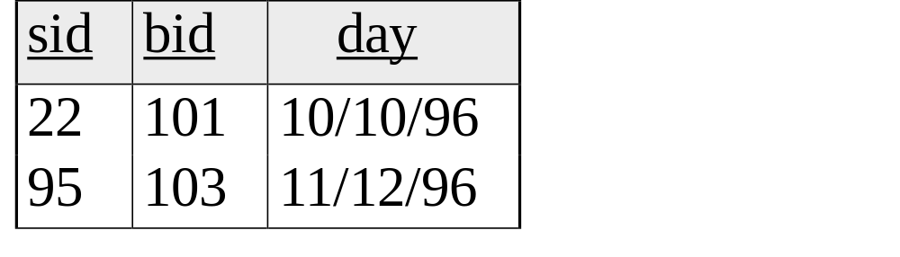
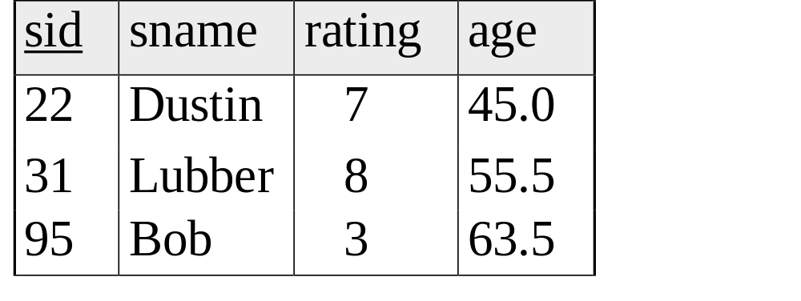
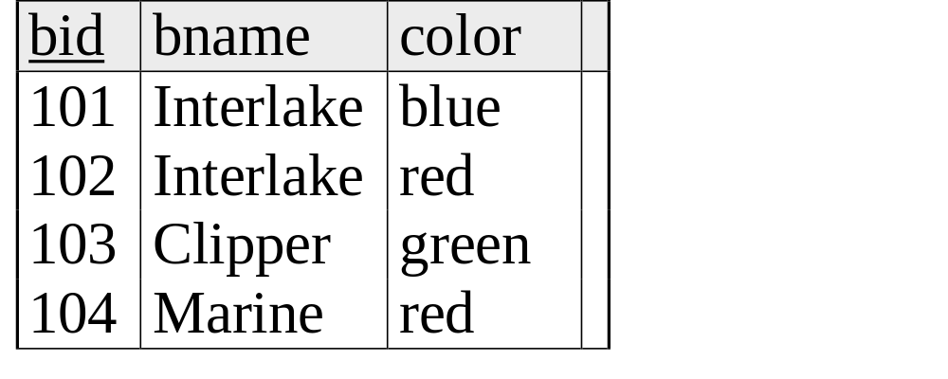
Now the Details
Reserves
Sailors
We will use these instances of relations in our examples.
Boats

Slide 19
Example Schemas (in SQL DDL)
CREATE TABLE Sailors (sid INTEGER, sname CHAR(20),rating INTEGER, age REAL,
PRIMARY KEY sid)
CREATE TABLE Boats (bid INTEGER, bname CHAR (20), color CHAR(10)
PRIMARY KEY bid)
CREATE TABLE Reserves (sid INTEGER, bid INTEGER, day DATE,
PRIMARY KEY (sid, bid, date),
FOREIGN KEY sid REFERENCES Sailors,
FOREIGN KEY bid REFERENCES Boats)

Slide 20
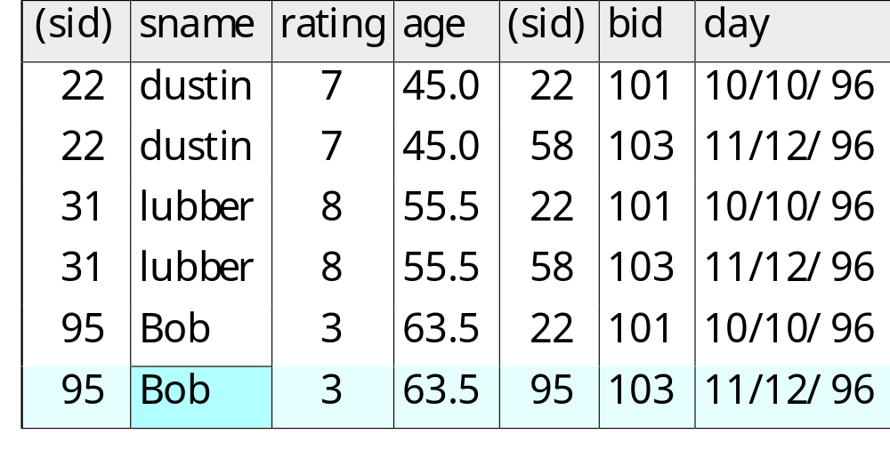
Another Join Query
SELECT sname
FROM Sailors, Reserves
WHERE Sailors.sid=Reserves.sid
AND bid=103

Slide 21
Some Notes on Range Variables
Can associate “range variables” with the tables in the FROM clause.
  saves writing, makes queries easier to understand
Needed when ambiguity could arise.
  for example, if same table used multiple times in same FROM (called a “self-join”)
SELECT sname
FROM Sailors,Reserves
WHERE Sailors.sid=Reserves.sid AND bid=103
Can be
rewritten using
range variables as:
SELECT S.sname
FROM Sailors S, Reserves R
WHERE S.sid=R.sid AND bid=103

Slide 22
More Notes
Here’s an example where range variables are required (self-join example):
Note that target list can be replaced by “*” if you don’t want to do a projection:
SELECT x.sname, x.age, y.sname, y.age
FROM Sailors x, Sailors y
WHERE x.age > y.age
SELECT *
FROM Sailors x
WHERE x.age > 20

Slide 23
Find sailors who’ve reserved at least one boat
SELECT S.sid
FROM Sailors S, Reserves R
WHERE S.sid=R.sid
Would adding DISTINCT to this query make a difference?
What is the effect of replacing S.sid by S.sname in the SELECT clause?
  Would adding DISTINCT to this variant of the query make a difference?

Slide 24
Expressions
Can use arithmetic expressions in SELECT clause (plus other operations we’ll discuss later)
Use AS to provide column names
Can also have expressions in WHERE clause:
SELECT S.age, S.age-5 AS age1, 2*S.age AS age2
FROM Sailors S
WHERE S.sname = ‘dustin’
SELECT S1.sname AS name1, S2.sname AS name2
FROM Sailors S1, Sailors S2
WHERE 2*S1.rating = S2.rating - 1

Slide 25
String operations
SQL also supports some string operations
“LIKE” is used for string matching.
  `_’ stands for any one character and `%’ stands for 0 or more arbitrary characters.
SELECT S.age, age1=S.age-5, 2*S.age AS age2
FROM Sailors S
WHERE S.sname LIKE ‘B_%B’

Slide 26
Find sid’s of sailors who’ve reserved a red or a green boat
UNION: Can be used to compute the union of any two union-compatible sets of tuples (which are themselves the result of SQL queries).
SELECT DISTINCT R.sid
FROM Boats B,Reserves R
WHERE R.bid=B.bid AND
(B.color=‘red’OR B.color=‘green’)
Vs.
(note:
UNION
eliminates
duplicates
by default.
Override w/
UNION ALL)
SELECT R.sid
FROM Boats B, Reserves R
WHERE R.bid=B.bid AND B.color=‘red’ UNION SELECT R.sid
FROM Boats B, Reserves R
WHERE R.bid=B.bid AND B.color=‘green’

Slide 27
Find sid’s of sailors who’ve reserved a red and a green boat
If we simply replace OR by AND in the previous query, we get the wrong answer. (Why?)
Instead, could use a self-join:
SELECT R1.sid
FROM Boats B1, Reserves R1,
Boats B2, Reserves R2
WHERE R1.sid=R2.sid
AND R1.bid=B1.bid
AND R2.bid=B2.bid
AND (B1.color=‘red’ AND B2.color=‘green’)
SELECT R.sid
FROM Boats B,Reserves R
WHERE R.bid=B.bid AND
(B.color=‘red’ AND B.color=‘green’)

Slide 28
AND Continued…
Key field!
INTERSECT:discussed in book. Can be used to compute the intersection of any two union-compatible sets of tuples.
Also in text: EXCEPT (sometimes called MINUS)
Included in the SQL/92 standard, but many systems don’t support them.
SELECT S.sid
FROM Sailors S, Boats B, Reserves R
WHERE S.sid=R.sid
AND R.bid=B.bid
AND B.color=‘red’
INTERSECT
SELECT S.sid
FROM Sailors S, Boats B, Reserves R
WHERE S.sid=R.sid
AND R.bid=B.bid
AND B.color=‘green’

Slide 29
Nested Queries
Powerful feature of SQL: WHERE clause can itself contain an SQL query!
  Actually, so can FROM and HAVING clauses.
To find sailors who’ve not reserved #103, use NOT IN.
To understand semantics of nested queries:
  think of a nested loops evaluation: For each Sailors tuple, check the qualification by computing the subquery.
Names of sailors who’ve reserved boat #103:
SELECT S.sname
FROM Sailors S
WHERE S.sid IN (SELECT R.sid
FROM Reserves R
WHERE R.bid=103)

Slide 30
Nested Queries with Correlation
Find names of sailors who’ve reserved boat #103:
SELECT S.sname
FROM Sailors S
WHERE EXISTS (SELECT *
FROM Reserves R
WHERE R.bid=103 AND S.sid=R.sid)
EXISTS is another set comparison operator, like IN.
Can also specify NOT EXISTS
If UNIQUE is used, and * is replaced by R.bid, finds sailors with at most one reservation for boat #103.
  UNIQUE checks for duplicate tuples in a subquery;
Subquery must be recomputed for each Sailors tuple.
  Think of subquery as a function call that runs a query!

Slide 31
More on Set-Comparison Operators
We’ve already seen IN, EXISTS and UNIQUE. Can also use NOT IN, NOT EXISTS and NOT UNIQUE.
Also available: op ANY, op ALL
Find sailors whose rating is greater than that of some sailor called Horatio:
SELECT *
FROM Sailors S
WHERE S.rating > ANY (SELECT S2.rating
FROM Sailors S2
WHERE S2.sname=‘Horatio’)

Slide 32
Rewriting INTERSECT Queries Using IN
Find sid’s of sailors who’ve reserved both a red and a green boat:
SELECT R.sid
FROM Boats B, Reserves R
WHERE R.bid=B.bid
AND B.color=‘red’
AND R.sid IN (SELECT R2.sid
FROM Boats B2, Reserves R2
WHERE R2.bid=B2.bid
AND B2.color=‘green’)
Similarly, EXCEPT queries re-written using NOT IN.
How would you change this to find names (not sid’s) of Sailors who’ve reserved both red and green boats?

Slide 33
Division in SQL
Find names of sailors who’ve reserved all boats.
Example in book, not using EXCEPT:
SELECT S.sname
FROM Sailors S
WHERE NOT EXISTS (SELECT B.bid
FROM Boats B
WHERE NOT EXISTS (SELECT R.bid
FROM Reserves R
WHERE R.bid=B.bid
AND R.sid=S.sid))
Sailors S such that ...
there is no boat B
that doesn’t have ...
a Reserves tuple showing S reserved B

Slide 34
Basic SQL Queries - Summary
An advantage of the relational model is its well-defined query semantics.
SQL provides functionality close to that of the basic relational model.
  some differences in duplicate handling, null values, set operators, etc.
Typically, many ways to write a query
  the system is responsible for figuring a fast way to actually execute a query regardless of how it is written.
Lots more functionality beyond these basic features.

Slide 35
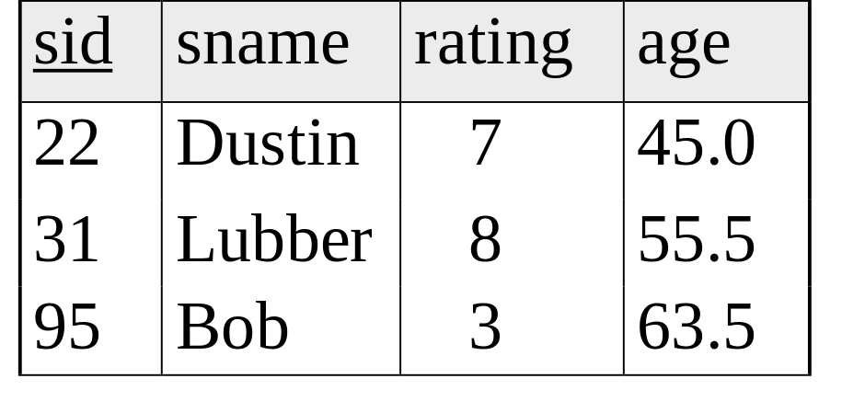
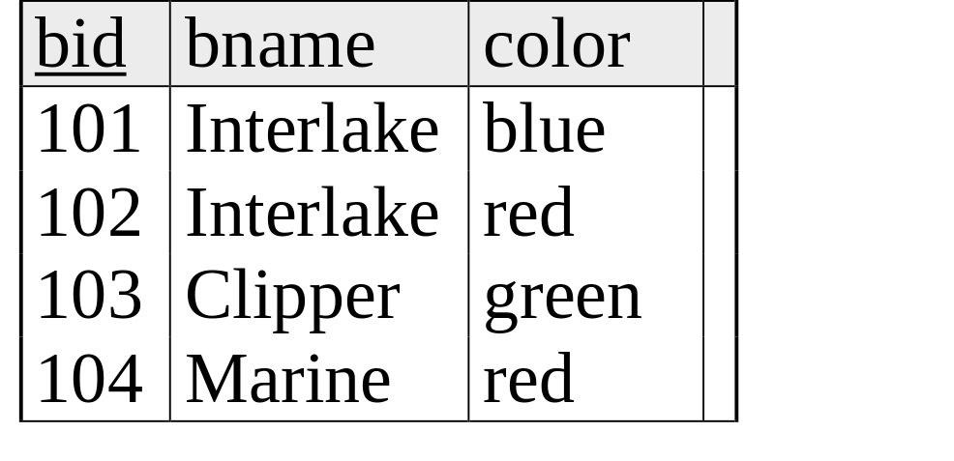
Example Instances
Reserves
Sailors
Boats

Slide 36
Aggregate Operators
COUNT (*)
COUNT ( [DISTINCT] A)
SUM ( [DISTINCT] A)
AVG ( [DISTINCT] A)
MAX (A)
MIN (A)
Significant extension of relational algebra.
SELECT COUNT (*)
FROM Sailors S
single column
SELECT AVG (S.age)
FROM Sailors S
WHERE S.rating=10
SELECT COUNT (DISTINCT S.rating)
FROM Sailors S
WHERE S.sname=‘Bob’

Slide 37
Aggregate Operators
(continued)
COUNT (*)
COUNT ( [DISTINCT] A)
SUM ( [DISTINCT] A)
AVG ( [DISTINCT] A)
MAX (A)
MIN (A)
single column
SELECT S.sname
FROM Sailors S
WHERE S.rating= (SELECT MAX(S2.rating)
FROM Sailors S2)

Slide 38
Find name and age of the oldest sailor(s)
SELECT S.sname, MAX (S.age)
FROM Sailors S
The first query is incorrect!
Third query equivalent to second query
  allowed in SQL/92 standard, but not supported in some systems.
SELECT S.sname, S.age
FROM Sailors S
WHERE S.age =
(SELECT MAX (S2.age)
FROM Sailors S2)
SELECT S.sname, S.age
FROM Sailors S
WHERE (SELECT MAX (S2.age)
FROM Sailors S2)
= S.age

Slide 39
GROUP BY and HAVING
So far, we’ve applied aggregate operators to all (qualifying) tuples.
  Sometimes, we want to apply them to each of several groups of tuples.
Consider: Find the age of the youngest sailor for each rating level.
  In general, we don’t know how many rating levels exist, and what the rating values for these levels are!
  Suppose we know that rating values go from 1 to 10; we can write 10 queries that look like this (!):
SELECT MIN (S.age)
FROM Sailors S
WHERE S.rating = i
For i = 1, 2, ... , 10:

Slide 40
Queries With GROUP BY
To generate values for a column based on groups of rows, use aggregate functions in SELECT statements with the GROUP BY clause
SELECT [DISTINCT] target-list
FROM relation-list
[WHERE qualification]
GROUP BY grouping-list
The target-list contains (i) list of column names &
(ii) terms with aggregate operations (e.g., MIN (S.age)).
  column name list (i) can contain only attributes from the grouping-list.

Slide 41
Group By Examples
For each rating, find the average age of the sailors
SELECT S.rating, AVG (S.age)
FROM Sailors S
GROUP BY S.rating
For each rating find the age of the youngest
sailor with age ≥ 18
SELECT S.rating, MIN (S.age)
FROM Sailors S
WHERE S.age >= 18
GROUP BY S.rating

Slide 42
Conceptual Evaluation
The cross-product of relation-list is computed, tuples that fail qualification are discarded, `unnecessary’ fields are deleted, and the remaining tuples are partitioned into groups by the value of attributes in grouping-list.
One answer tuple is generated per qualifying group.

Slide 43
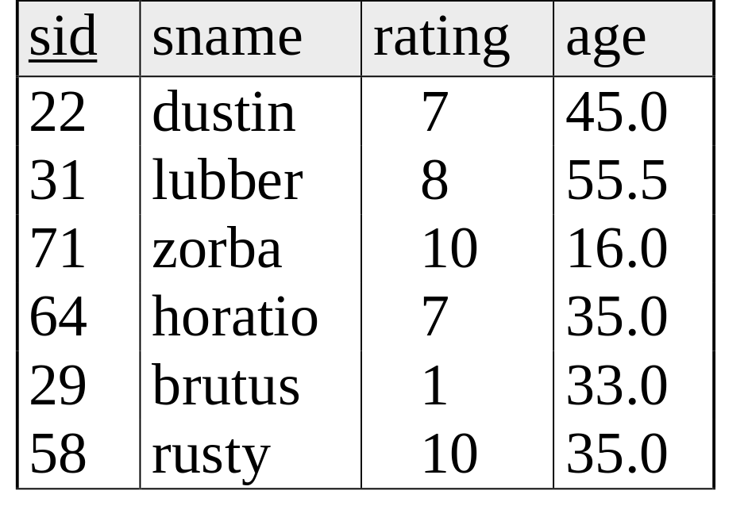
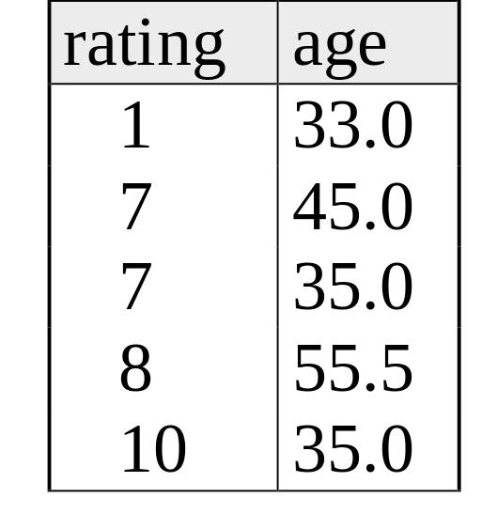
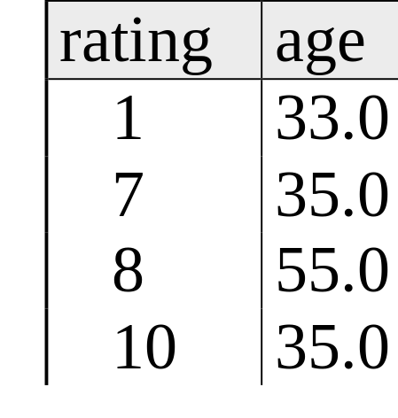
SELECT S.rating, MIN (S.age)
FROM Sailors S
WHERE S.age >= 18
GROUP BY S.rating
Answer Table
3. Perform Aggregation
1. Form cross product
2. Delete unneeded columns, rows; form groups

Slide 44
Find the number of reservations for each red boat.
SELECT B.bid, COUNT(*)AS scount
FROM Boats B, Reserves R
WHERE R.bid=B.bid
AND B.color=‘red’
GROUP BY B.bid
Grouping over a join of two relations.

Slide 45
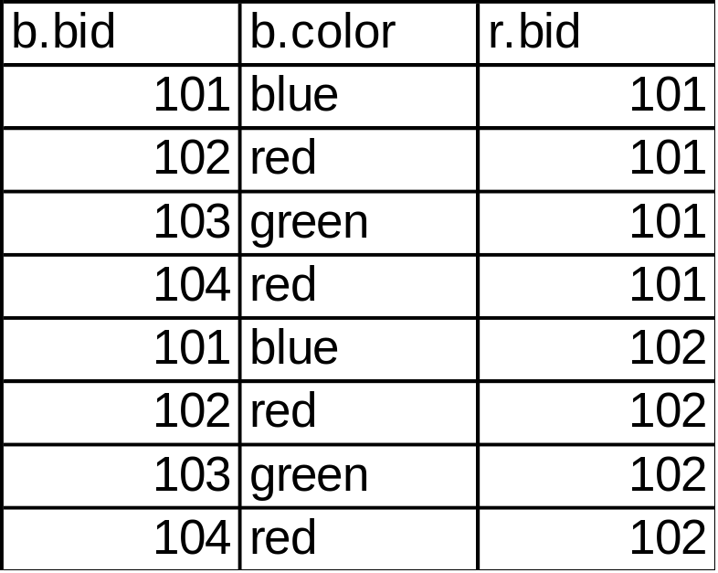
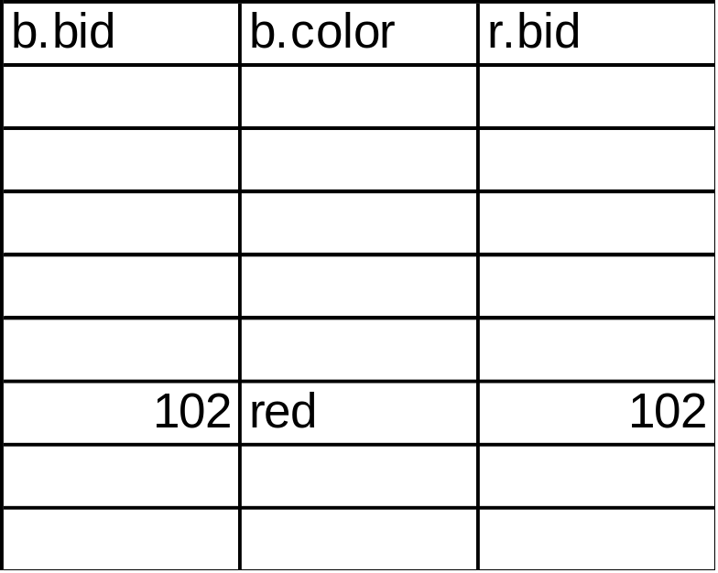
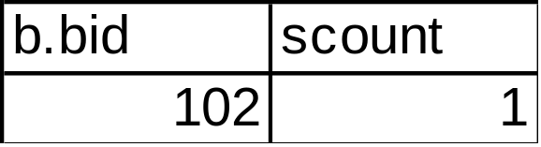
SELECT B.bid, COUNT (*) AS scount
FROM Boats B, Reserves R
WHERE R.bid=B.bid AND B.color=‘red’
GROUP BY B.bid
1
2
answer

Slide 46
Queries With GROUP BY and HAVING
SELECT [DISTINCT] target-list
FROM relation-list
WHERE qualification
GROUP BY grouping-list
HAVING group-qualification
Use the HAVING clause with the GROUP BY clause to restrict which group-rows are returned in the result set

Slide 47
Conceptual Evaluation
Form groups as before.
The group-qualification is then applied to eliminate some groups.
  Expressions in group-qualification must have a single value per group!
  That is, attributes in group-qualification must be arguments of an aggregate op or must also appear in the grouping-list. (SQL does not exploit primary key semantics here!)
One answer tuple is generated per qualifying group.

Slide 48
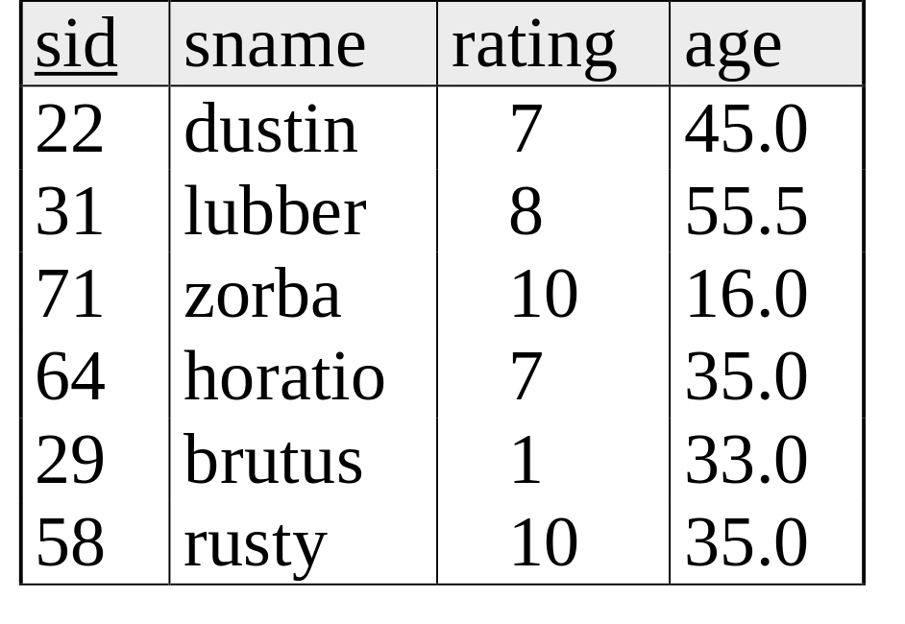
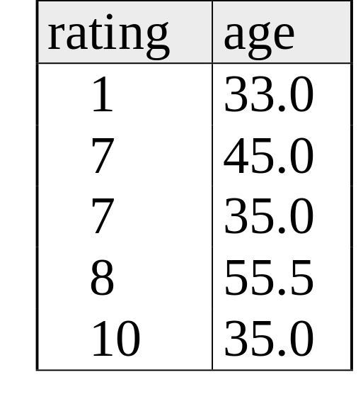
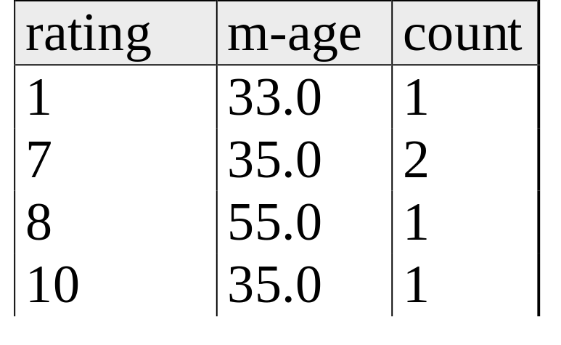

Find the age of the youngest sailor with age ≥ 18, for each rating with at least 2 such sailors
SELECT S.rating, MIN (S.age)
FROM Sailors S
WHERE S.age >= 18
GROUP BY S.rating
HAVING COUNT (*) > 1
Answer relation

Slide 49
Find names of sailors who’ve reserved all boats.
Example in book, not using EXCEPT:
SELECT S.sname
FROM Sailors S
WHERE NOT EXISTS (SELECT B.bid
FROM Boats B
WHERE NOT EXISTS (SELECT R.bid
FROM Reserves R
WHERE R.bid=B.bid
AND R.sid=S.sid))
Sailors S such that ...
there is no boat B without ...
a Reserves tuple showing S reserved B

Slide 50
Find names of sailors who’ve reserved all boats.
Can you do this using Group By and Having?
SELECT S.name
FROM Sailors S, reserves R
WHERE S.sid = R.sid
GROUP BY S.name, S.sid
HAVING
COUNT(DISTINCT R.bid) =
( Select COUNT (*) FROM Boats)
Note: must have both sid and name in the GROUP BY
clause. Why?

Slide 51
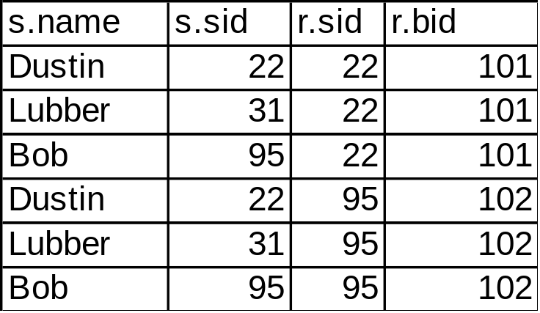

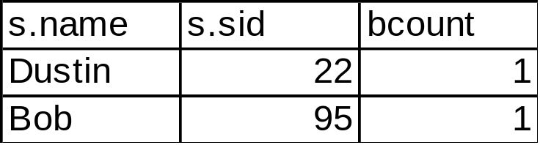
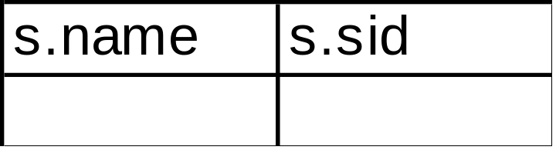
SELECT S.name, S.sid
FROM Sailors S, reserves R
WHERE S.sid = r.sid
GROUP BY S.name, S.sid
HAVING
COUNT(DISTINCT R.bid) =
Select COUNT (*) FROM Boats
Count (*) from boats = 4
Apply having clause to groups

Slide 52
INSERT
INSERT [INTO] table_name [(column_list)]
VALUES ( value_list)
INSERT [INTO] table_name [(column_list)]
<select statement>
INSERT INTO Boats VALUES ( 105, ‘Clipper’, ‘purple’)
INSERT INTO Boats (bid, color) VALUES (99, ‘yellow’)
You can also do a “bulk insert” of values from one
table into another:
INSERT INTO TEMP(bid)
SELECT r.bid FROM Reserves R WHERE r.sid = 22;
(must be type compatible)

Slide 53
DELETE & UPDATE
DELETE [FROM] table_name
[WHERE qualification]
DELETE FROM Boats WHERE color = ‘red’
DELETE FROM Boats b
WHERE b. bid =
(SELECT r.bid FROM Reserves R WHERE r.sid = 22)
Can also modify tuples using UPDATE statement.
UPDATE Boats
SET Color = “green”
WHERE bid = 103;

Slide 54
Null Values
Field values in a tuple are sometimes unknown (e.g., a rating has not been assigned) or inapplicable (e.g., no spouse’s name).
  SQL provides a special value null for such situations.
The presence of null complicates many issues. E.g.:
  Special operators needed to check if value is/is not null.
  Is rating>8 true or false when rating is equal to null? What about AND, OR and NOT connectives?
  We need a 3-valued logic (true, false and unknown).
  Meaning of constructs must be defined carefully. (e.g., WHERE clause eliminates rows that don’t evaluate to true.)
  New operators (in particular, outer joins) possible/needed.

Slide 55
Joins
SELECT (column_list)
FROM table_name
[INNER | {LEFT |RIGHT | FULL } OUTER] JOIN table_name
ON qualification_list
WHERE …
Explicit join semantics needed unless it is an INNER join
(INNER is default)

Slide 56
Inner Join
Only the rows that match the search conditions are returned.
SELECT s.sid, s.name, r.bid
FROM Sailors s INNER JOIN Reserves r
ON s.sid = r.sid
Returns only those sailors who have reserved boats
SQL-92 also allows:
SELECT s.sid, s.name, r.bid
FROM Sailors s NATURAL JOIN Reserves r
“NATURAL” means equi-join for each pair of attributes with the same name (may need to rename with “AS”)

Slide 57
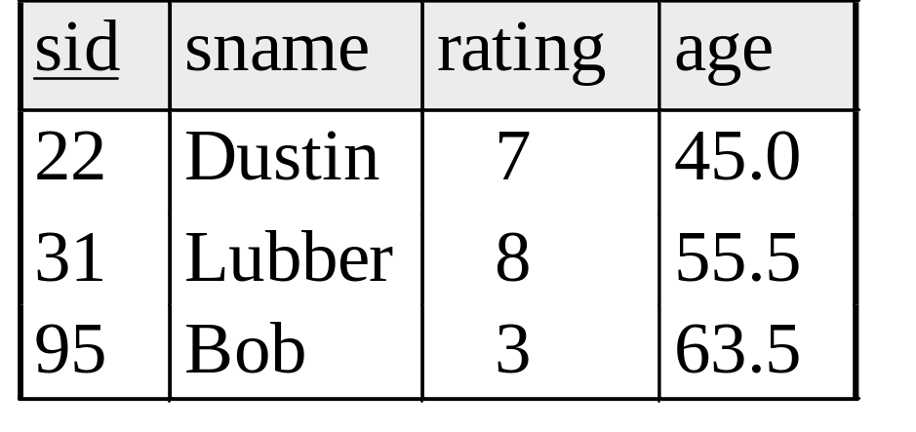
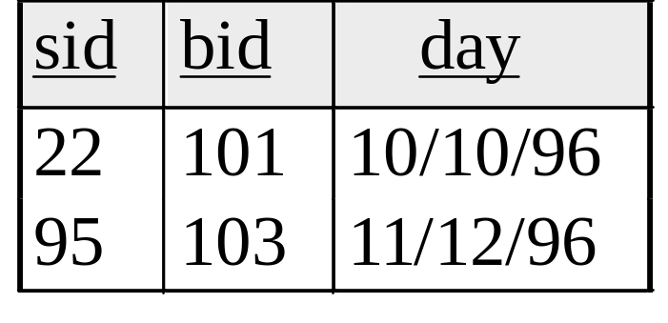
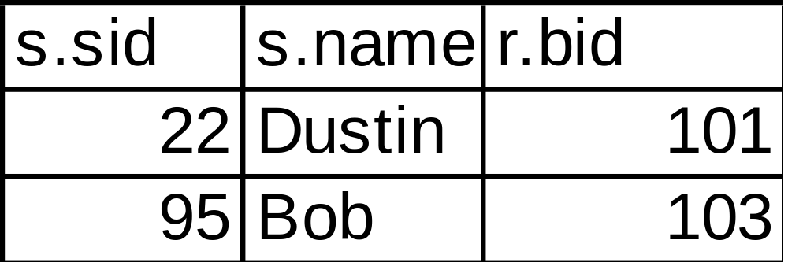
SELECT s.sid, s.name, r.bid
FROM Sailors s INNER JOIN Reserves r
ON s.sid = r.sid

Slide 58
Left Outer Join
Left Outer Join returns all matched rows, plus all unmatched rows from the table on the left of the join clause
(use nulls in fields of non-matching tuples)
SELECT s.sid, s.name, r.bid
FROM Sailors s LEFT OUTER JOIN Reserves r
ON s.sid = r.sid
Returns all sailors & information on whether they have reserved boats

Slide 59
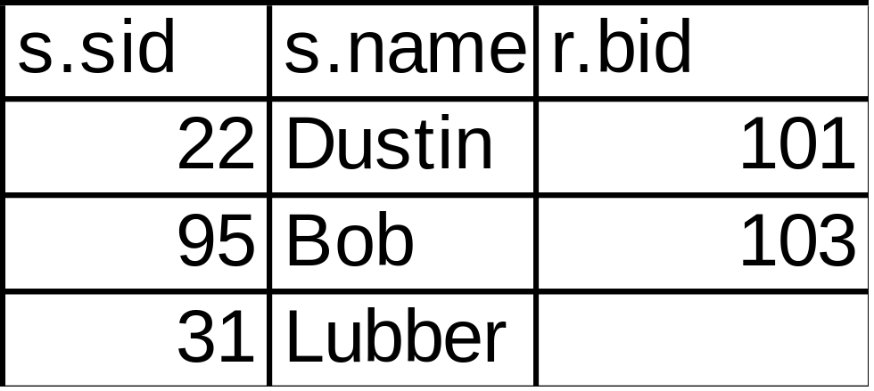
SELECT s.sid, s.name, r.bid
FROM Sailors s LEFT OUTER JOIN Reserves r
ON s.sid = r.sid

Slide 60
Right Outer Join
Right Outer Join returns all matched rows, plus all unmatched rows from the table on the right of the join clause
SELECT r.sid, b.bid, b.name
FROM Reserves r RIGHT OUTER JOIN Boats b
ON r.bid = b.bid
Returns all boats & information on which ones are reserved.

Slide 61
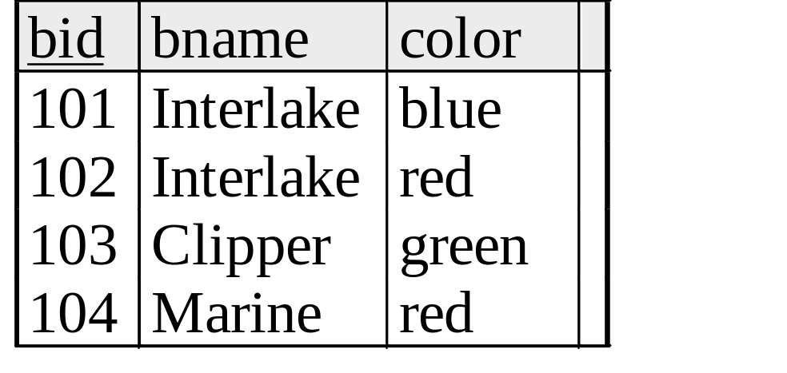
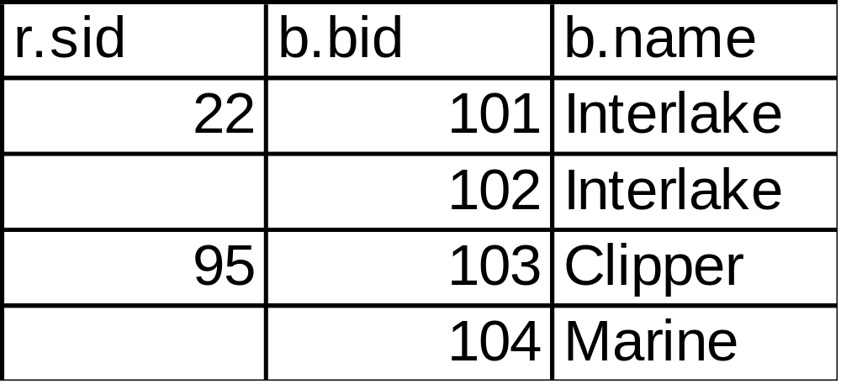
SELECT r.sid, b.bid, b.name
FROM Reserves r RIGHT OUTER JOIN Boats b
ON r.bid = b.bid

Slide 62
Full Outer Join
Full Outer Join returns all (matched or unmatched) rows from the tables on both sides of the join clause
SELECT r.sid, b.bid, b.name
FROM Reserves r FULL OUTER JOIN Boats b
ON r.bid = b.bid
Returns all boats & all information on reservations

Slide 63
SELECT r.sid, b.bid, b.name
FROM Reserves r FULL OUTER JOIN Boats b
ON r.bid = b.bid
Note: in this case it is the same as the ROJ because
bid is a foreign key in reserves, so all reservations must
have a corresponding tuple in boats.

Slide 64
Views
CREATE VIEW view_name
AS select_statement
Makes development simpler
Often used for security
Not instantiated - makes updates tricky
CREATE VIEW Reds
AS SELECT B.bid, COUNT (*) AS scount
FROM Boats B, Reserves R
WHERE R.bid=B.bid AND B.color=‘red’
GROUP BY B.bid

Slide 65
CREATE VIEW Reds
AS SELECT B.bid, COUNT (*) AS scount
FROM Boats B, Reserves R
WHERE R.bid=B.bid AND B.color=‘red’
GROUP BY B.bid
Reds

